Slide 1
OSHA Updates, Recordkeeping and Reporting Requirements
ASSP Florida Suncoast Chapter and ASA
4-11-2024
Olja Correa Compliance Assistance Specialist Occupational Safety and Health Administration

Slide 2
OSHA - Compliance Assistance Specialist (CAS) Tampa Area Office
VPP Team Leader, Outreach, Alliance, Strategic Partnerships Coordinator
2 years in the current position
Compliance Safety and Health Officer (Industrial Hygienist), OSHA
Served for 9 years
Conducted over 500 Enforcement Inspections
Military Officer, The United States Army Chemical Corps (2003-2012)
Special operations for WMD-E
Positions held:
Battalion Future Operations Officer in Charge
Company Executive Officer
Special Operations Team Leader
Analytical Team Leader
Education and Certifications
MBA
Studied Biomedical Science
United States Army, Chemical Corps, CBRN-E Officer Training
Tech Escort Trained / Certified
Extensive Occupational Health and Safety Training
Military Leadership Training

Slide 3
Disclaimer:
This information has been developed by an OSHA Compliance Assistance Specialist and is intended to assist employers, workers, and others improve workplace health and safety. While we attempt to thoroughly address specific topics or hazards, it is not possible to include discussion of everything necessary to ensure a healthy and safe working environment in this presentation. This information is a tool for addressing workplace hazards and is not an exhaustive statement of an employer’s legal obligations, which are defined by statute, regulations, and standards. This document does not have the force and effect of law and is not meant to bind the public in any way. This document is intended only to provide clarity to the public regarding existing requirements under the law or agency policies. It does not create or diminish legal obligations under the Occupational Safety and Health Act. Finally, OSHA may modify rules and related interpretations in light of new technology, information, or circumstances; to keep apprised of such developments, or to review information on a wide range of occupational safety and health topics, you can visit OSHA’s website at www.osha.gov.

Slide 4
OSHA Updates:

Slide 5
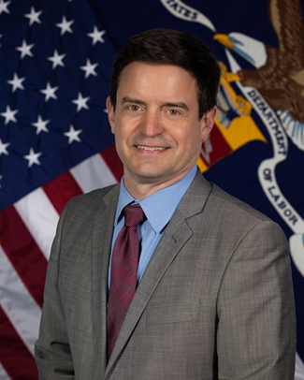
Leadership for DOL - OSHA
Acting Secretary of Labor – Julie Su
Douglas L. Parker - Assistant Secretary
of Labor for Occupational Safety and Health
James (Jim) Frederick- Deputy Assistant
Secretary of Labor for Occupational Safety
and Health
Amanda Edens- Deputy Assistant
Secretary of Labor for Occupational
Safety and Health
Notes:
Julie Su became Acting Secretary of Labor or March 11, 2023. She was previously confirmed by the Senate to serve as the deputy secretary of labor on July 13, 2021.
Douglas L. Parker
Assistant Secretary of Labor for Occupational Safety and Health (sworn in on November 3, 2021)
Served as Deputy Assistant Secretary for Policy in the Department of Labor’s Mine Safety and Health Administration
James (Jim) Frederick
Deputy Assistant Secretary of Labor for Occupational Safety and Health
United Steelworkers union (USW), Assistant Director of Health, Safety and Environment
Julie Su
Amanda Edens joined the Occupational Safety and Health Administration in 1985 as an industrial hygienist. In 2002, she served as the director for the Office of Chemical Hazards-Metals in OSHA’s Directorate of Standards and Guidance, and in 2007 became deputy director of the Directorate of Standards and Guidance. Ms. Edens has also served on details as acting director for the agency’s Directorate of Evaluation and Analysis and Directorate of Enforcement Programs.

Slide 6
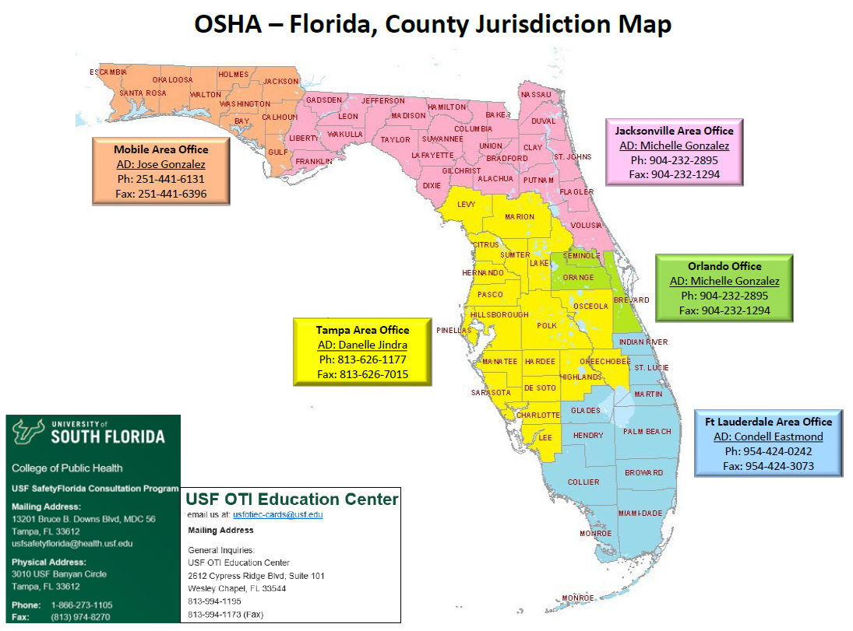
Florida Reorganization – Effective July 27st, 2023
Jacksonville Area Office
AD: David Tisdale “Scott”
Ph: 904-232-2895
Fax: 904-232-1294
Orlando Office
AD: Sarah Carle
Ph: 904-232-2895
Fax: 904-232-1294
Orlando Office
AD: Erin Sanchez
Ph: 904-232-2895
Fax: 904-232-1294

Slide 7
OSHA Penalty Levels: 2024 (after January 15, 2024)
Type of Violation | New Maximum
Serious and Other-Than-Serious Posting Requirements | $16,131 per violation
Willful or Repeated | $161,323 per violation
Failure to Abate | $16,131 per day beyond the abatement date
www.osha.gov/penalties
Notes:
[Note to presenters: For a PPT on OSHA’s penalty levels, see the O drive at DCSP/CAS Resources/Presentations/Penalties/.]
Below are the maximum penalty amounts, with the annual adjustment for inflation, that may be assessed after Jan. 15, 2024.

Slide 8
Top Ten Violations in FY 2023
Most frequently cited OSHA standards during FY 2023 inspections.
Fall Protection – General Requirements (1926.501)
Hazard Communication (1910.1200)
Ladders (1926.1053)
Scaffolding (1926.451)
Powered Industrial Trucks (1910.178)
Lockout/Tagout (1910.147)
Respiratory Protection (1910.134)
Fall Protection – Training Requirements (1926.503)
Eye and Face Protection (1926.102)
10. Machine Guarding (1910.212)
Notes:
This is a PRELIMINARY list of the top 10 most frequently cited standards following inspections of worksites by federal OSHA (all federal RIDs). OSHA publishes this list to alert employers about these commonly cited standards so they can take steps to find and fix recognized hazards addressed in these and other standards before OSHA shows up.
[The list is very similar to the list for FY 2021– it is the same ten standards in a slightly different order.]
The following slides show the top 5 sub-sections that OSHA cites for each of these standards. Again, this is preliminary and subject to change.
There were about 47,000 citations in total, and citations under these top ten account for a bit more than half of them (more than 24,000).)
Note: Slide deck updated 8-25-23.

Slide 9
Top Ten Violations in General Industry
FY 2023
Respiratory Protection (1910.134)
Hazard Communication (1910.1200)
Powered Industrial Trucks (1910.178)
General Requirements, Electrical (1910.303)
Control of Hazardous Energy, Lockout/Tagout (1910.147)
Wiring Methods, Components, and Equipment for General use (1910.305)
Maintenance, safeguards, and operational features for exit routes (1910.37)
General Requirements, PPE (1910.132)
Portable Fire Extinguishers (1910.157)
Healthcare (1910.502) (Note: ETS withdrawn 12/2022)
Notes:
This is a PRELMINARY list of the top 10 most frequently cited OSHA standards during inspections of general industry worksites in FY 2022. OSHA uses the term "general industry" to refer to all industries not included in agriculture, construction or maritime. NOTE: Final FY 2022 numbers are not available until April 2023. This top 10 list is based on data pulled 01/11/2023 (OIS Standards Cited Report: All Fed RIDS, Industry Sector: General Industry, Issuance Dates: 10/1/2021-9/30/2022, Standard Level: Std Part and Sect)
The COVID-19 Healthcare Emergency Temporary Standard (ETS) at 1910.502 was issued on June 21, 2021. Under the OSH Act, an ETS is effective until superseded by a permanent standard – a process contemplated by the OSH Act to occur within 6 months of the ETS’s promulgation. 29 U.S.C. 655(c). OSHA intends to continue to work expeditiously to issue a final standard that will protect healthcare workers from COVID-19 hazards, and will do so as it also considers its broader infectious disease rulemaking. However, given that a final rule cannot be completed in a timeframe approaching the one contemplated by the OSH Act, on December 27, 2021, OSHA withdrew the non-recordkeeping portions. The COVID-19 log and reporting provisions, 29 CFR 1910.502(q)(2)(ii), (q)(3)(ii)-(iv), and (r), remain in effect. These provisions were adopted under a separate provision of the OSH Act, section 8, and OSHA found good cause to forgo notice and comment in light of the grave danger presented by the pandemic. See 86 FR 32559.

Slide 10
Florida Update – 2023 Fatalities
In 2023, in Florida we had 106 fatalities work-related (111 in 2022).
Construction: 51 %
General Industry: 18%
Lawn and Garden Care, Agriculture: 13%

Slide 11
Notes:
Number and rate of fatal work injuries, by private industry sector (bls.gov)
https://www.bls.gov/charts/census-of-fatal-occupational-injuries/number-and-rate-of-fatal-work-injuries-by-industry.htm

Slide 12
National Emphasis Programs (NEPs):
NEPs: Heat, Combustible Dust, Hazardous Machinery, Hexavalent Chromium, Lead, Primary Metal Industries, Process Safety Management, Shipbreaking, Respirable Crystalline Silica, Trenching and Excavation, Covid-19, Falls in all Industries, Warehousing and Distribution Center Operations (10-13-2023)
Notes:
National Emphasis Programs (NEPs) are temporary programs that focus OSHA's resources on particular hazards and high-hazard industries. Existing and potential new emphasis programs are evaluated using inspection data, injury and illness data, National Institute for Occupational Safety and Health (NIOSH) reports, peer-reviewed literature, analysis of inspection findings, and other available information sources.

Slide 13
National Emphasis Programs:
https://www.osha.gov/enforcement/directives/nep

Slide 14
Regional/Local Emphasis Programs (LEPs):
Notes:
Falls in all industries is one of our major National Emphasis Programs.
https://www.osha.gov/enforcement/directives/lep

Slide 15
Regional/Local Emphasis Programs (LEPs):
https://www.osha.gov/enforcement/directives/lep

Slide 16
What is the Regulatory Agenda?
Regulatory Agenda informs public of federal agencies’ regulatory priorities
Published twice a year in Spring and Fall in Reginfo.gov
Regulatory Plan (published as part of Fall Agenda) has more details about the most significant regulatory actions

Slide 17
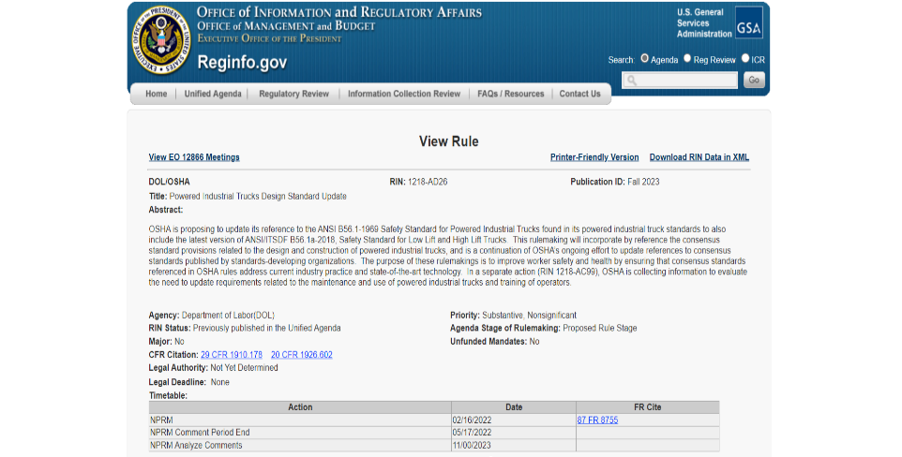
Regulatory Agenda Entry Example
Notes:
This is what a regulatory agenda entry looks like on the Reginfo.gov site.
Each item in the agenda is assigned a RIN, or Regulatory Identification Number, which is its unique identifier.
Each item includes an abstract that provides background, as well as a list of actions taken or planned, and the associated dates.

Slide 18
Improve Tracking of Workplace Injuries and Illnesses
Finalized rule in 2016 that, among other things, required certain establishments to electronically submit certain case-specific injury and illness information to OSHA each year.
Rescinded the requirement to submit the case-specific information; however, OSHA is proposing to again institute this requirement.
Final Rule issued July 2023 and became effective January 1, 2024.
Notes:
In 2016, OSHA finalized a rule which, among other things, required certain establishments to electronically submit certain case-specific injury and illness information to OSHA each year (81 FR 29624 (May 12, 2016))
Approximately three years later, the agency rescinded the requirements to submit the case-specific information (84 FR 380 (January 25, 2019)). On March 30, 2022, OSHA published a Notice of Proposed Rulemaking which would amend its occupational injury and illness recordkeeping regulation to again require certain employers to annually electronically submit injury and illness information (87 FR 18528).
Specifically, OSHA proposed to amend its regulation to require establishments with 100 or more employees in certain designated industries to electronically submit information from their OSHA Forms 300, 301, and 300A to OSHA once a year.
OSHA also proposed to update the classification system used to determine the list of industries covered by the electronic submission requirement. Finally, OSHA proposed to remove the current requirement for establishments with 250 or more employees, not in a designated industry, to electronically submit information from their Form 300A to OSHA on an annual basis.

Slide 19
Recordkeeping and Reporting Requirements

Slide 20
Reportable vs. Recordable
Specific injuries are required to be reported
Fatality (8 hours)
Amputation or Loss of an eye (24 hours)
In-patient hospitalization (24 Hours)
The clock starts once a team leader, supervisor, or manager has knowledge that the injury is reportable
If the injury is serious enough to qualify as reportable, there will be a high likelihood that it will be recordable
An injury is not reportable if it meets the qualifications after 24 hours of the actual injury/incident
1904.39(b)(6) “For an in-patient hospitalization, amputation, or loss of an eye, you must only report the event to OSHA if it occurs within twenty-four (24) hours of the work-related incident.”
Does not apply to fatality
All fatalities must be reported regardless of timeframe

Slide 21
Reportable vs. Recordable
Definitions
1904.39(b)(9) How does OSHA define "in-patient hospitalization"? OSHA defines inpatient hospitalization as a formal admission to the in-patient service of a hospital or clinic for care or treatment.
1904.39(b)(10) Do I have to report an in-patient hospitalization that involves only observation or diagnostic testing? No, you do not have to report an in-patient hospitalization that involves only observation or diagnostic testing. You must only report to OSHA each inpatient hospitalization that involves care or treatment.
1904.39(b)(11) How does OSHA define "amputation"? An amputation is the traumatic loss of a limb or other external body part. Amputations include a part, such as a limb or appendage, that has been severed, cut off, amputated (either completely or partially); fingertip amputations with or without bone loss; medical amputations resulting from irreparable damage; amputations of body parts that have since been reattached. Amputations do not include avulsions, enucleations, deglovings, scalpings, severed ears, or broken or chipped teeth.

Slide 22
Reportable vs. Recordable
How do I report the fatality, amputation, or hospitalization?
Call your local OSHA office. Offices are in Jacksonville, Orlando, Tampa, and Ft. Lauderdale
Call the OSHA 24-hour hotline at 1-800-321-6742 (OSHA)
Or report the incident online at:
https://www.osha.gov/ords/ser/serform.html
Unsure if reportable or recordable?
Call any area office and ask for the Duty Officer available from 8:00 am – 4:30 PM
Contact USF SafetyFlorida to schedule a consultation
Contact OTI for available recordkeeping courses

Slide 23
Recordkeeping Overview
Who has to maintain and submit logs
Exemptions
Size
Ten or fewer
20 or greater per establishment
Industry – NAICS Code (North American Industry Classification System)
(https://www.osha.gov/laws-regs/regulations/standardnumber/1904/1904SubpartBAppA)

Slide 24
Recording Criteria
Covered employers must record each fatality, injury, or illness that:
Is work-related
Is a new case
Meets one or more of the criteria in sections 1904.7 through 1904.11.

Slide 25
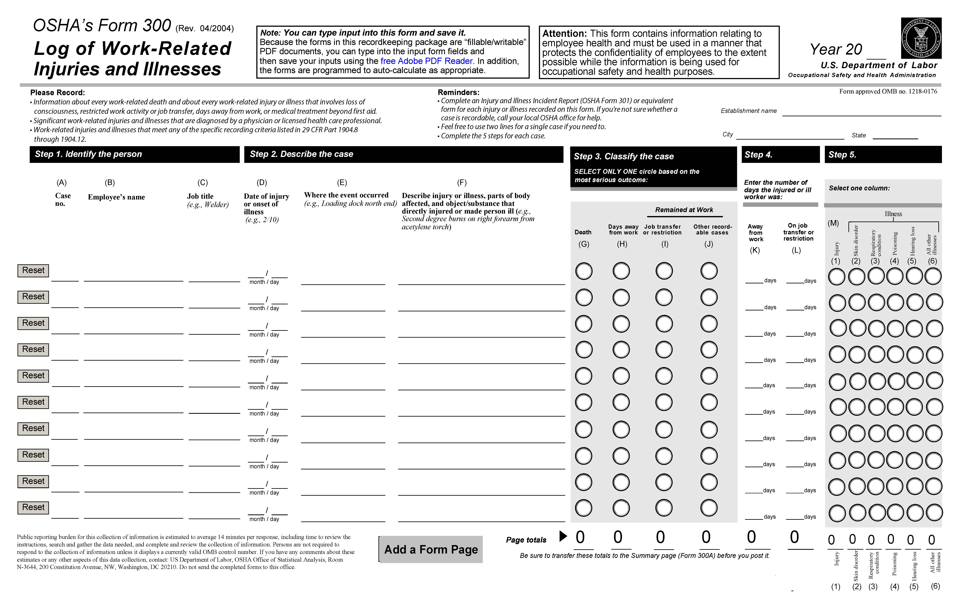
OSHA Forms/Logs:
300

Slide 26
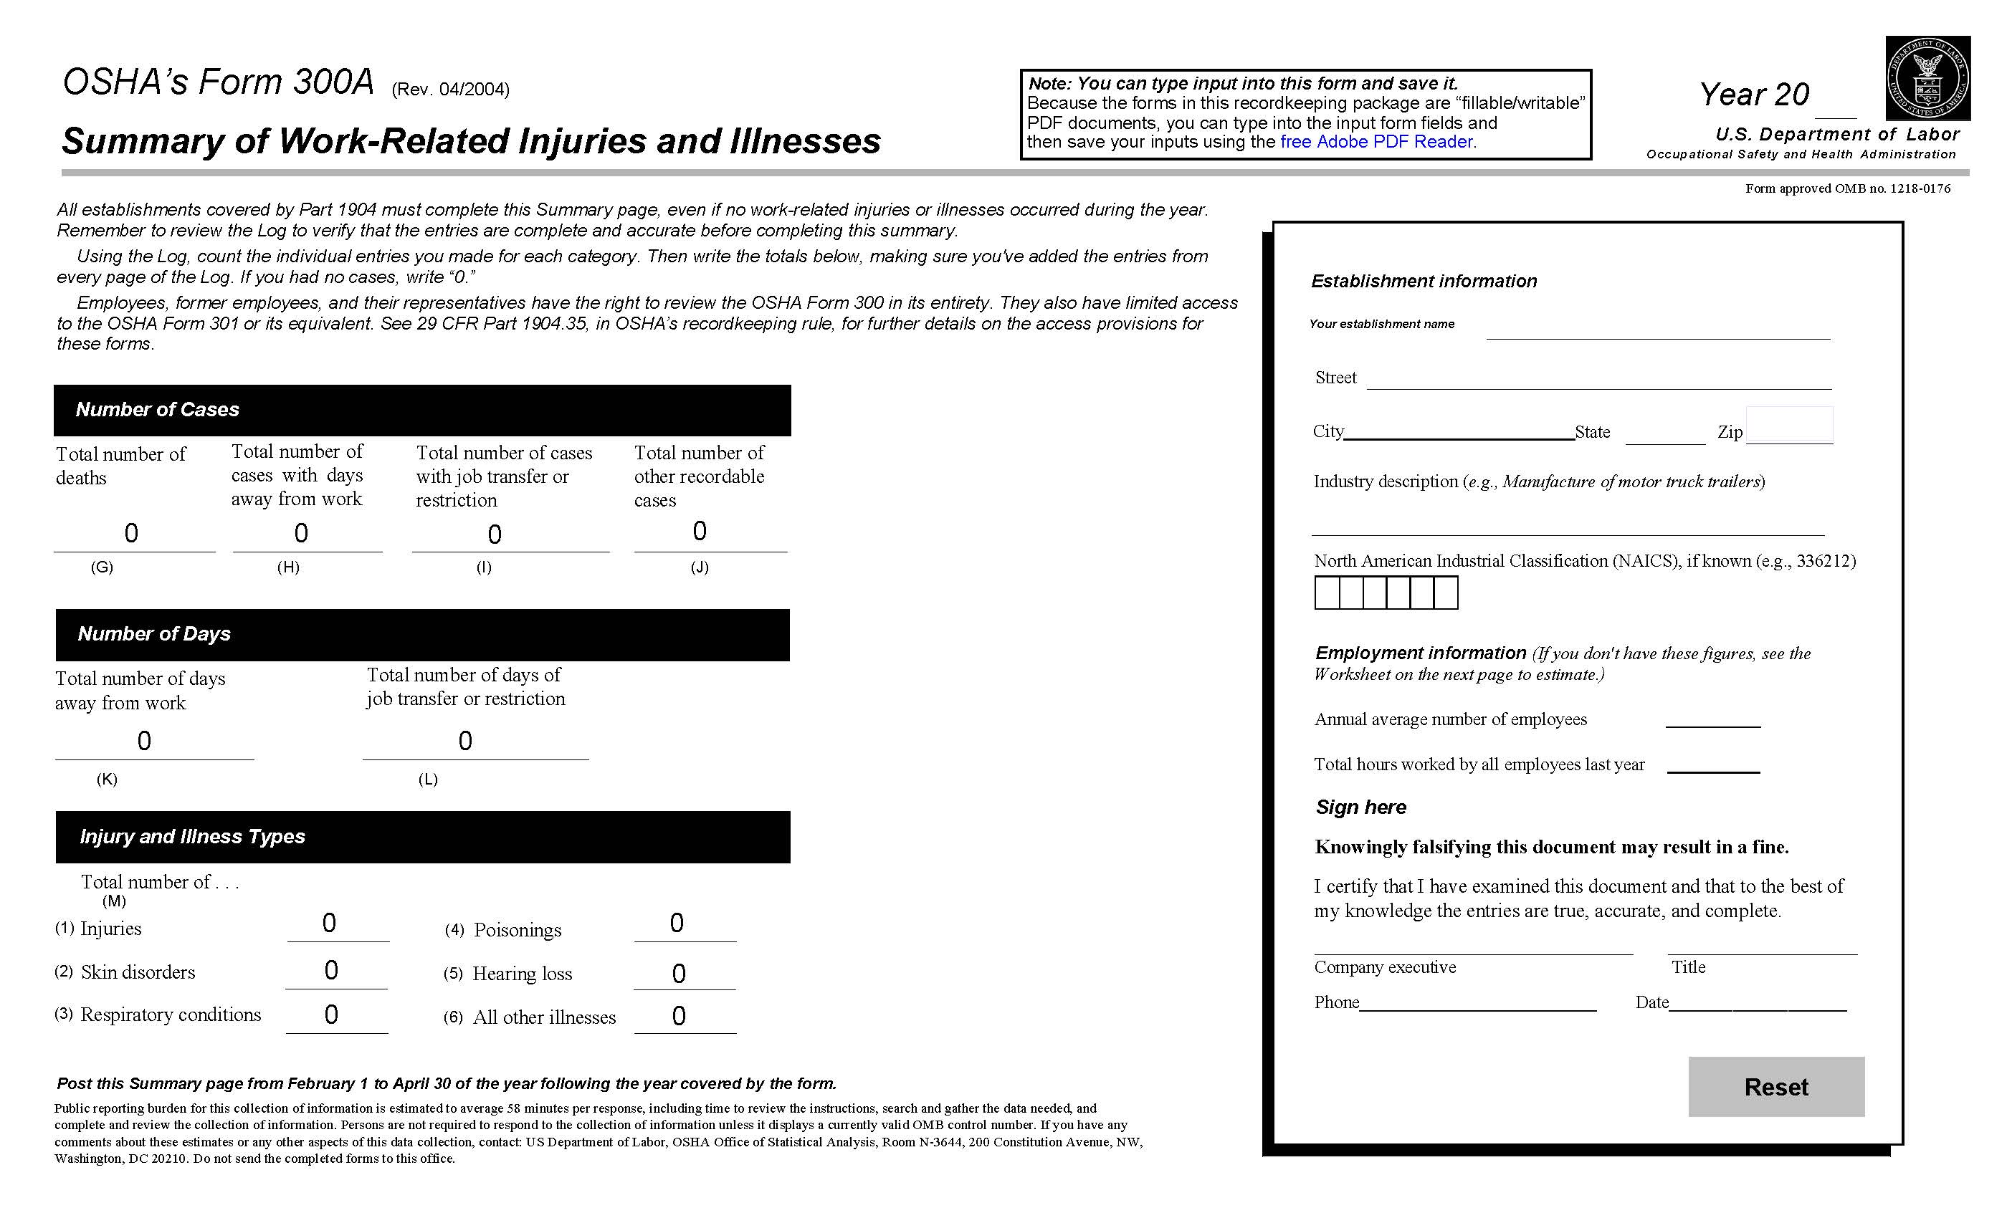
300A

Slide 27
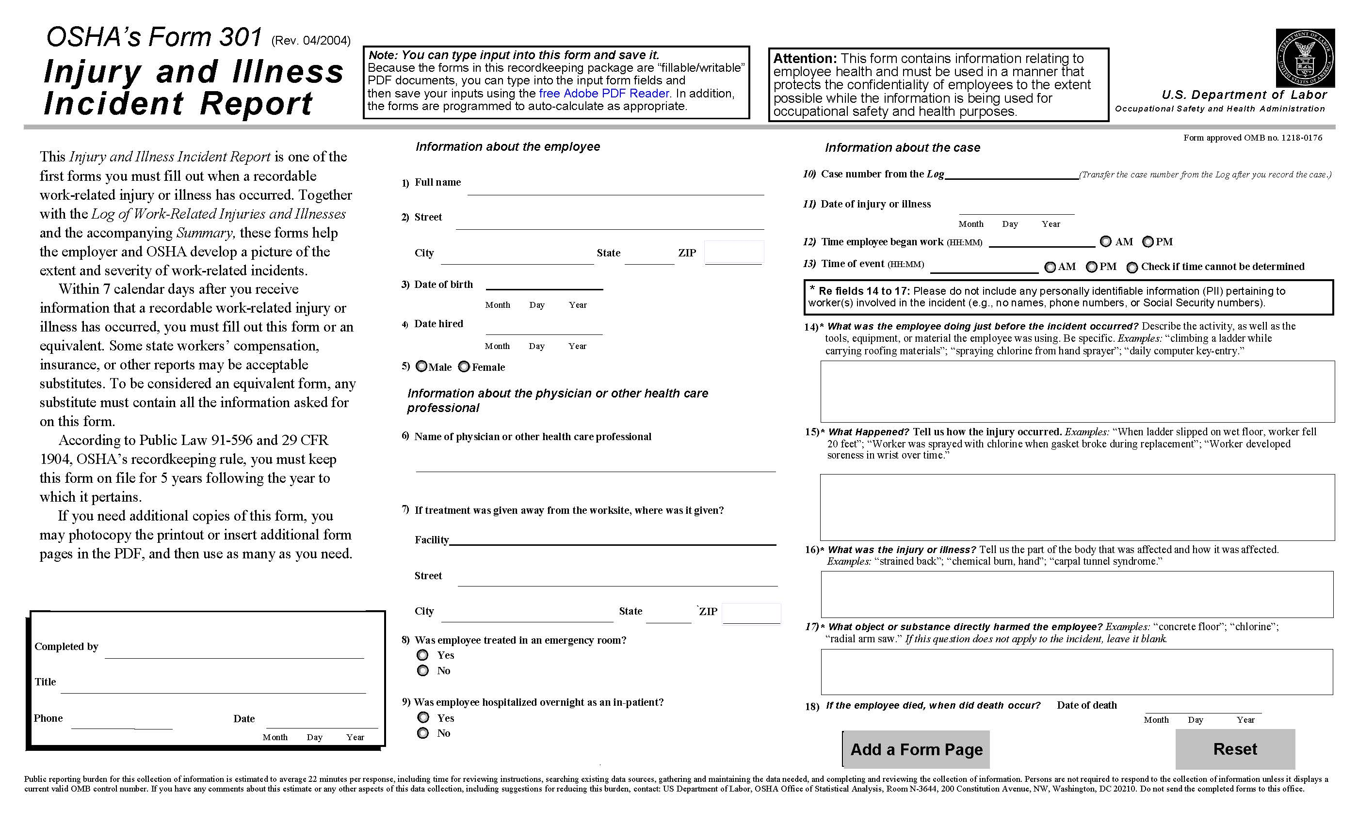
301

Slide 28
Additional Information
Zero Injuries
Logs must still be maintained and submitted
Multiple business establishments
Covered employees
1904.31(a) Basic requirement. You must record on the OSHA 300 Log the recordable injuries and illnesses of all employees on your payroll, whether they are labor, executive, hourly, salary, part-time, seasonal, or migrant workers. You also must record the recordable injuries and illnesses that occur to employees who are not on your payroll if you supervise these employees on a day-to-day basis. If your business is organized as a sole proprietorship or partnership, the owner or partners are not considered employees for recordkeeping purposes
Temporary Employees
Retention of logs - 5 years****

Slide 29
Construction
Temporary job site injuries are recorded on the headquarters log
One-year temporary establishment must maintain injury/illness logs but only for employees of the general contractor on-site
Subcontractors are not included
Temporary workers vs. Subcontractors

Slide 30
Resources:
https://www.osha.gov/recordkeeping/presentations
PowerPoint Presentation on Recordkeeping
https://www.osha.gov/recordkeeping
Main recordkeeping page
https://www.osha.gov/report
Reporting severe injuries page

Slide 31
The Final Rule to Improve Tracking of Workplace Injuries and Illnesses

Slide 32
Main Purpose of Final Rule
Prevent worker injuries and illnesses.
With the information obtained through this rule, OSHA, employers, employees, employee representatives, State and local agencies, consultants, and researchers will be better able to identify and mitigate workplace hazards and thereby prevent worker injuries and illnesses.
Notes:
Main Purpose of Final Rule:
Avoid worker accidents and health issues. This rule will provide valuable data to OSHA, employers, workers, employee representatives, state and local agencies, consultants, and researchers, enabling them to more effectively recognize and reduce workplace dangers, ultimately leading to the prevention of worker injuries and illnesses.

Slide 33
Final Rule to Amend Recordkeeping Requirements
On July 21, 2023, OSHA published a final rule to amend federal occupational injury and illness recordkeeping regulation: 29 CFR 1904.41 effective date is January 1, 2024.
The final rule supports the agency's mission to assure safe and healthful working conditions for working people.
Notes:
Final Rule to Amend Recordkeeping Requirements:
OSHA released a final rule on July 21, 2023, aimed at modifying the federal occupational injury and illness recordkeeping rule, specifically 29 CFR 1904.41, which will come into effect on January 1, 2024. This rule change aligns with the agency's core mission of ensuring a safe and healthy workplace environment for all employees.
Test Question:
22. OSHA must issue a citation within ___ of the occurrence of the violation: (TLO 5)
Three months
Six months
Twelve months
Five years
23. Citations are signed by the OSHA Area Director but they are not effective until they become a final order of: (TLO 5)
The Assistant Secretary for OSHA
The Occupational Safety and Health Review Commission
The Solicitor of Labor
The Secretary of Labor

Slide 34
Final Rule to Improve Tracking
Certain establishments must electronically submit to OSHA detailed information about each recordable injury and illness entered on their previous calendar year's OSHA 300 Log and 301 Incident Report forms (29 CFR 1904.41). This includes the date, physical location, and severity of the injury or illness; details about the worker who was injured; and details about how the injury or illness occurred.
Notes:
Final Rule to Improve Tracking:
Specific businesses are obligated to electronically furnish OSHA with comprehensive data regarding every injury and illness that was recorded in their OSHA 300 Log and 301 Incident Report forms from the preceding calendar year (29 CFR 1904.41). This information encompasses the injury or illness's date, its physical location, and the level of severity. It also includes particulars about the affected worker and the circumstances surrounding the occurrence of the injury or illness.

Slide 35
Final Rule Requirements
Establishments with 100 or more employees in the highest-hazard industries must electronically submit information from their Form 300 Log and Form 301 Incident Report. (Establishments that had a peak employment of 100 or more employees during the previous calendar year meet this size criteria.) Listed in appendix B to subpart E.
Establishments with 20 or more employees in certain high-hazard industries, and all establishments with 250 or more employees in industries that are routinely required to keep injury and illness records, must continue to electronically submit information from their Form 300A Annual Summary. Listed in appendix A to subpart E.
Establishments are required to include their legal company name in their submission.
Notes:
Final Rule Requirements:
Establishments in the highest-risk industries with 100 or more employees must electronically provide data from their Form 300 Log and Form 301 Incident Report. (Establishments that had a peak workforce of 100 or more employees in the preceding calendar year meet this size requirement.) This is detailed in appendix B to subpart E.
Additionally, Establishments in specific high-risk industries with 20 or more employees, as well as all companies with 250 or more employees in industries that are routinely mandated to maintain injury and illness records, must continue to electronically submit data from their Form 300A Annual Summary, as outlined in appendix A to subpart E.
It is mandatory for establishments to include their legal company name in their submission.
Test Question:
22. OSHA must issue a citation within ___ of the occurrence of the violation: (TLO 5)
Three months
Six months
Twelve months
Five years
23. Citations are signed by the OSHA Area Director but they are not effective until they become a final order of: (TLO 5)
The Assistant Secretary for OSHA
The Occupational Safety and Health Review Commission
The Solicitor of Labor
The Secretary of Labor

Slide 36
Final Rule to Improve Tracking
The designated industries are listed in Appendix B to Subpart E of 29 C.F.R. Part 1904
1904 Subpart E App A - Appendix A to Subpart E of Part 1904-Designated Industries for §1904.41(a)(2) Annual Electronic Submission of OSHA Form 300A Summary of Work-Related Injuries and Illnesses by Establishments With 20 or More Employees but Fewer Than 250 Employees in D | Occupational Safety and Health Administration (no change)
Notes:
https://www.osha.gov/injuryreporting/final-rule

Slide 37
Injury Tracking Application (ITA)
Establishments under Federal OSHA jurisdiction can use the ITA Coverage Application to determine if they are required to electronically report their injury and illness information to OSHA. Establishments under State Plan jurisdiction should directly contact their State Plan.

Slide 38
Check if Your Business is Required to Report
https://www.osha.gov/itareportapp

Slide 39
Protection of Worker Privacy:
OSHA will not collect worker names and addresses;
OSHA will convert birth dates to age and discard birth dates;
OSHA will remind employers not to submit information that could directly identify workers, such as names, addresses, telephone numbers, etc.;
OSHA will withhold from publication the information on age, gender, date hired, and whether the worker was treated in an emergency room and/or hospitalized overnight as an in-patient;
OSHA will use automated information technology to detect and remove any remaining information that could directly identify workers.
Notes:
Test Question:
22. OSHA must issue a citation within ___ of the occurrence of the violation: (TLO 5)
Three months
Six months
Twelve months
Five years
23. Citations are signed by the OSHA Area Director but they are not effective until they become a final order of: (TLO 5)
The Assistant Secretary for OSHA
The Occupational Safety and Health Review Commission
The Solicitor of Labor
The Secretary of Labor

Slide 40
Some Benefits of the Final Rule
Improve OSHA’s ability to use its enforcement and compliance assistance resources by enabling OSHA to identify the workplaces where workers are at high risk.
Increase OSHA’s effectiveness and efficiency by providing establishment-specific, case-specific injury and illness data for analyses that are not currently possible.
Increase OSHA’s ability to identify and respond to emerging hazards.
Improve the ability of employers, employees, employee representatives, and researchers to identify and mitigate workplace hazards and thereby prevent worker injuries and illnesses.
Notes:
Test Question:
22. OSHA must issue a citation within ___ of the occurrence of the violation: (TLO 5)
Three months
Six months
Twelve months
Five years
23. Citations are signed by the OSHA Area Director but they are not effective until they become a final order of: (TLO 5)
The Assistant Secretary for OSHA
The Occupational Safety and Health Review Commission
The Solicitor of Labor
The Secretary of Labor

Slide 41
To Learn More:
Learn more about OSHA's Injury and Illness Recordkeeping and Reporting Requirements at osha.gov/recordkeeping.
Learn more about OSHA’s electronic submission requirements at osha.gov/injuryreporting.
Submit a Workplace Safety and Health Question | Occupational Safety and Health Administration (osha.gov)

Slide 42
Resources:
Improve Tracking of Workplace Injuries and Illnesses (osha.gov) – fact sheet
Help for Employers | Occupational Safety and Health Administration (osha.gov)
Federal Register: Improve Tracking of Workplace Injuries and Illnesses

Slide 43
Frequently Asked Questions
How do I create an ITA account?
-The steps to create an ITA account and connect it to a Login.gov account are explained in the Create an ITA Account and Create a Login.gov Account job aids. You can also watch our How To Video, which covers the account creation process.

Slide 44
Cont.
I submitted my Form 300A data before the due date but I have subsequently learned of a new recordable case that occurred last year. Do I need to edit and resubmit my information?
- You are not required to submit updated information after your original submission, but you may do so if you wish. (Note that you are required to update your OSHA Form 300 to reflect the new information). To edit the data follow these steps:
Login to the ITA and choose View Establishment List
Click on the establishment name link of the facility you want to edit
Click on Edit 300A Summary
Make your changes and save them
Re-submit the data.

Slide 45
Cont.
Does OSHA notify employers that they need to report their Form 300A data? And if not, where do I get my Username and Password to login and provide my data?
- OSHA does not send out notifications to report the Form 300A data. If your establishment meets the industry and size reporting criteria, you must create an account in the Injury Tracking Application (ITA) and connect the ITA account to a Login.gov account with the same email address. Once you create your account, you can login and report your Form 300A data on an annual basis. Each year the data are due by March 2nd. To create an ITA account, go to the Injury Tracking Application Login page and select the Create an ITA Account link that is right below the Injury Tracking Application banner. Follow the instructions from there.

Slide 46
Cont.
I missed the March 2nd deadline for submitting my Form 300A data. Can I still submit the data?
- Yes, the ITA will accept your Form 300A data through the end of the calendar year (December 31). You must electronically submit the data if you are required to do so.

Slide 47
Cont.
Are the electronic reporting requirements based on the size of the establishment or the size of the firm?
- The electronic reporting requirements are based on the size of the establishment, not the firm. The OSHA injury and illness records are maintained at the establishment level. An establishment is defined as a single physical location where business is conducted or where services or industrial operations are performed. A firm may be comprised of one or more establishments. To determine if you need to provide OSHA with the required data for an establishment, you need to determine the establishment's peak employment during the last calendar year. Each individual employed in the establishment at any time during the calendar year counts as one employee, including full-time, part-time, seasonal, and temporary workers.

Slide 48
Cont.
My firm has multiple establishments that do different things. Which determines whether I have to submit data for those establishments: the industry classification of the firm or the industry classification of the establishment?
-The electronic reporting requirements are based on the industry classification of the establishment, not the industry classification of the firm. An establishment is defined as a single physical location where business is conducted or where services or industrial operations are performed. A firm may be comprised of one or more establishments.

Slide 49
Cont.
My company operates multiple facilities on a campus setting. Each facility has less than 250 employees, but the campus has more than 250 employees. How should I count my employees to determine if I have to electronically provide OSHA with my injury and illness records?
- The recording and reporting requirements of Part 1904 are establishment-based. Under most circumstances, a campus is a single physical location and is considered a single establishment. Under limited conditions, you may consider two or more separate facilities that share a single location to be separate establishments. You may divide one location into two or more establishments only when: 1) each facility represents a distinctly separate business; 2) each facility is engaged in a different economic activity; 3) no one industry description applies to the joint activities of the establishments; and 4) separate reports are routinely prepared for each establishment concerning each establishment's number of employees, employee wage and salary rates, sales or receipts, and other business information.

Slide 50
Cont.
I am submitting the required data for multiple establishments. All of my establishments have the same name, but the system will not allow me to use a name more than once. What can I do?
-Each establishment name must be unique. You can make each unique by adding a number or a city/town name to the end of the establishment name. For example, if your establishment name is XYZ, you can make each location unique in the following manners: XYZ – 1, XYZ – 2, XYZ – 3; or XYZ Atlanta, XYZ Smyrna, XYZ Savannah.

Slide 51
Cont.
May a firm with multiple establishments make a single submission of the data from the multiple establishments?
- A firm with more than one establishment must submit establishment-specific 300A data for each establishment that meets the size and industry reporting criteria. These data may be submitted using one ITA account. It is important to note that the electronic reporting requirements are for data at the establishment level, not the firm level. An establishment is defined as a single physical location where business is conducted or where services or industrial operations are performed. A firm may be comprised of one or more establishments. The submitted data must be specific for each individual establishment.

Slide 52
Cont.
May a third party submit data for an establishment or firm?
-Yes, just as a third party is allowed to maintain the injury and illness records for an employer, a third party is allowed to submit the data for that employer. However, as with recordkeeping, responsibility for the completeness and accuracy of the data lies with the employer, not the third party.

Slide 53
Cont.
I want multiple staff members to access the information in my account. How do I give them access?
- To provide an ITA account holder access to your establishment data, follow these steps:
[Note: Before these steps are taken, ensure that the staff member has already created an ITA account.]
1.Login to the ITA and choose "View Establishment List"
2.Select on the establishment name link
3.Then select "Assign User"
4.Enter the e-mail address of the other ITA account holder
5.Select "User Role"
6.Then, select Save

Slide 54
Cont.
A company is located with multiple buildings within one complex. Can I produce one log for the complex or do I need to have one log for each building?
-You may complete one log for the complex. Generally, there should be one log per "establishment". An establishment is defined as a single physical location and can include campus and complex type locations.

Slide 55
Cont.
A supervisor was shouting at an employee. The employee felt stressed and his general doctor told him to take some time off from work. Is this an OSHA 300 recordable case?
- Mental illnesses, such as depression or anxiety disorder, that have work-related stress as a contributing factor, are recordable if the employee voluntarily provides the employer with an opinion from a physician or other licensed health care professional with appropriate training and experience (psychiatrist, psychologist, psychiatric nurse practitioner, etc.) stating that the employee has a mental illness that is work-related, and the case meets one or more of the general recording criteria.

Slide 56
OSHA’s FY 2024 Calander of Events -Outreach Initiatives coming up:
April 25
Save the date: Workers Memorial ceremony, live in Washington, D.C. and virtual, 1:00 p.m. ET.

Slide 57
Additional OSHA’s FY 2024 Outreach Initiatives:
May 6-10 – National Safety Stand-Down to Prevent Falls in Construction
May 24 – Don’t Fry day
June 17-21 – Trench Safety Stand Down Week
August 12-18 - Safe + Sound Week (JHA)
August 26-30 - Labor Rights Week

Slide 58
On-Site Consultation Program
Free, confidential advice to small sized businesses
Priority to high-hazard worksites
Separate from enforcement
No penalties or citations
Safety Florida Consultation Program University of South Florida
13201 Bruce B. Downs Boulevard, MDC 56 Tampa, Florida 33612
1-866-273-1105
www.usfsafetyflorida.com

Slide 59
USF OSHA Training Institute Education Center (USF OTIEC)
www.usfotiec.org
813-974-2284
2612 Cypress Ridge Blvd.
Wesley Chapel, FL 33544
Courses offered in FL, AL, GA, KY, MS, NC, SC, TN
The USF OTI Education Center has a focused curriculum that includes Outreach Training Program trainer courses and occupational safety and health standards courses in:
General Industry,
Maritime,
Construction
Disaster Site Worker Training
USF OTIEC also offers Hazardous Waste Operations and Emergency Response including the 8-Hour, 24-Hour, and 40-Hour classes. Other Technical courses include:
Respiratory Protection
Introduction to Industrial Hygiene
Permit Required Confined Space
Machinery and Machine Guarding
Fall Hazard Awareness
Electrical Safety
Hazardous Materials
Excavation, Trenching, Soil Mechanics
Ergonomics

Slide 60
OSHA Poster – It’s the Law!
It’s free and required
Employers must display in a conspicuous location
Available in several languages
State Plans may have their own versions
www.osha.gov/publications/poster
Notes:
The OSHA Job Safety and Health: It's the Law poster, available for free from OSHA, informs workers of their rights under the Occupational Safety and Health Act. All covered employers are required to display the poster in their workplace. Employers do not need to replace previous versions of the poster. Employers must display the poster in a prominent place where workers can see it.
The poster is also available in Spanish, Arabic, Cebuano, Chinese, Haitian Creole, Korean, Marshallese, Nepali, Polish, Portuguese, Tagalog, and Vietnamese. (Marshallese translation was newly produced in 2022!)

Slide 61
For continual updates:
Visit OSHA’s website to sign up to receive OSHA information:
QuickTakes biweekly newsletter
Tip of the Day
www.osha.gov/contactus
Follow OSHA on social media
Twitter: @OSHA_DOL
Facebook: Follow the Department of Labor page

Slide 62
QUESTIONS?
www.osha.gov
800-321-OSHA (6742)
My e-mail is correa.olja@dol.gov

